Slide 1
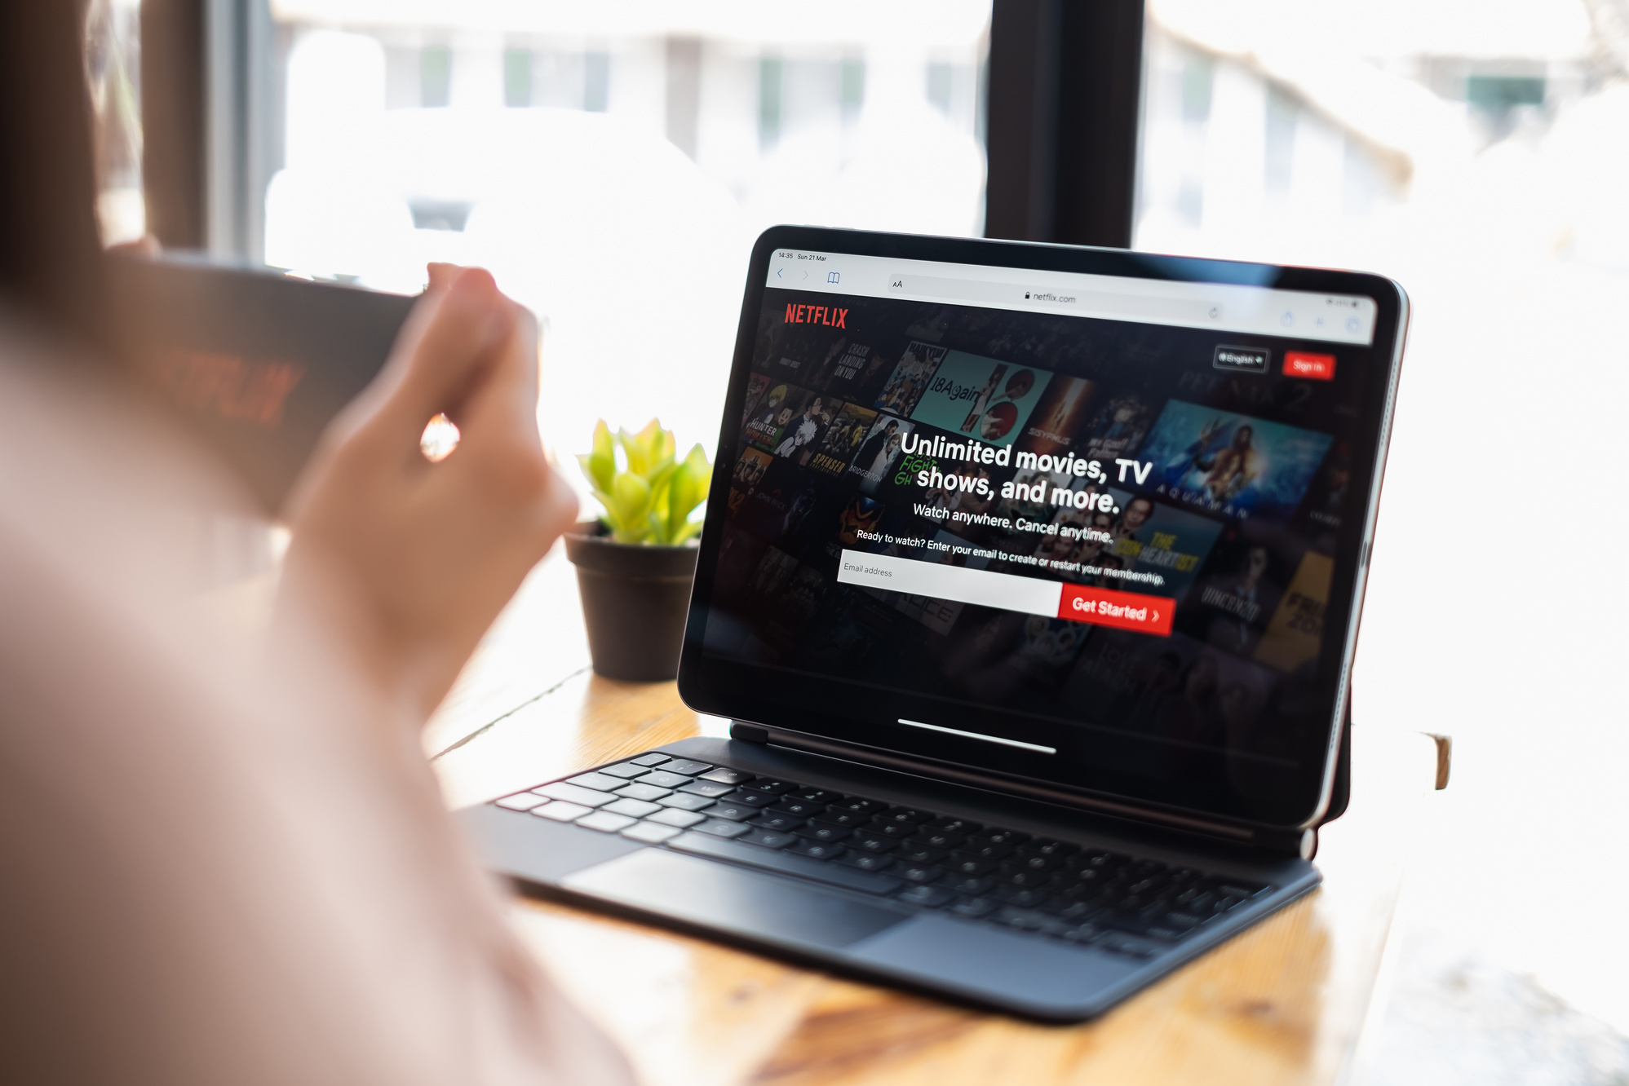
Netflix Data Analytics: Key Insights for Strategic Growth
A Data-Driven Approach to Optimizing Content and Global Engagement

Slide 2
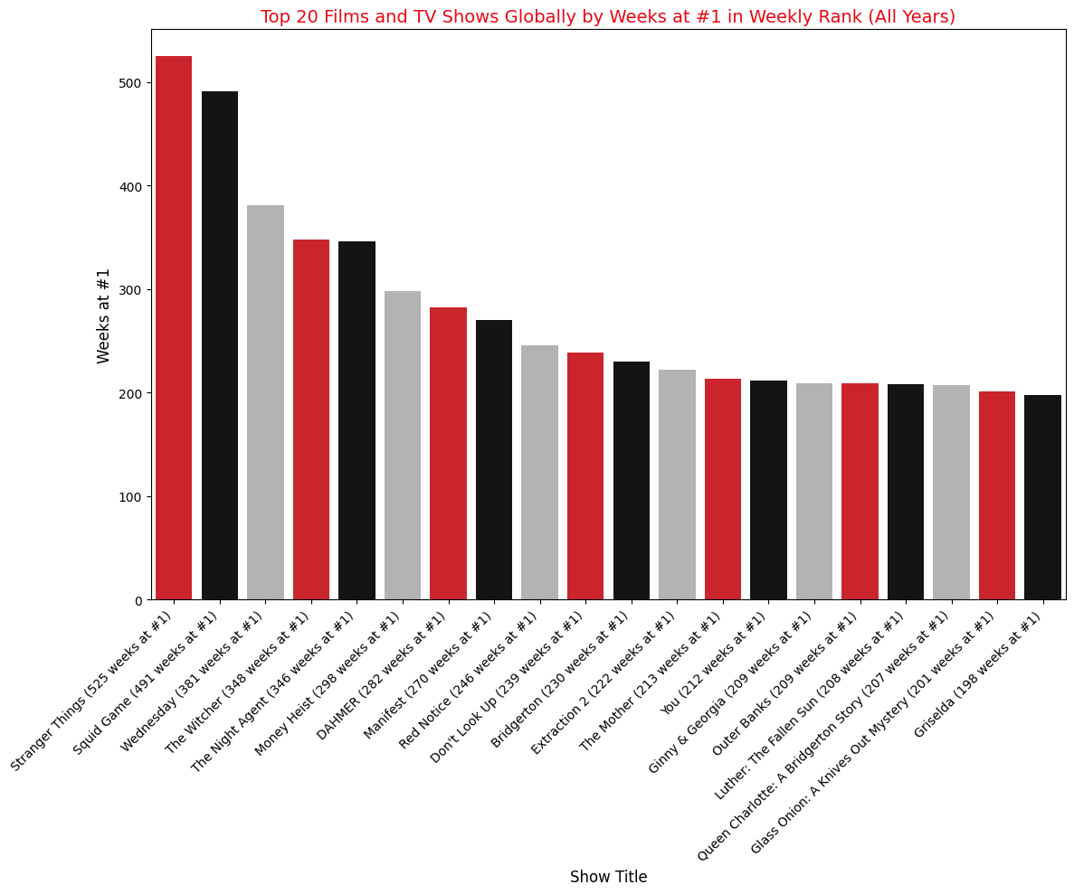
Top 20 Films and TV Shows Globally by Weeks at #1
Shows like Stranger Things and Squid Game dominate globally, with over 400 weeks at #1, signaling high retention and global engagement.
Diverse genres: The top shows cover a wide range of genres, including sci-fi (Stranger Things), dystopian thrillers (Squid Game), and fantasy (The Witcher), indicating that Netflix's audience enjoys varied content.
Serialized storytelling: Shows with multiple seasons, such as Stranger Things and Money Heist, tend to perform better over time, with audiences staying engaged over more extended periods.
Language diversity: The mix of English and non-English content in the top rankings shows the growing demand for international programming, particularly from regions such as South Korea and Spain.

Slide 3
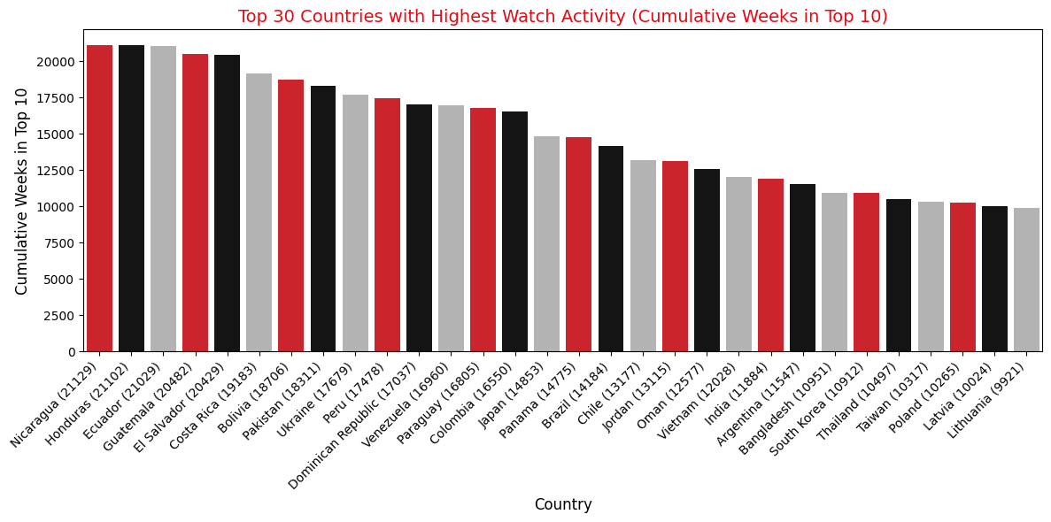
Top 30 Countries with Highest Watch Activity
Countries like Nicaragua and Ecuador dominate the top spots for cumulative watch weeks. This data indicates key markets for localized content strategies.
Key drivers of success include
Genre variety: a mix of science fiction, horror, and drama that appeals to diverse audiences.
Longer runtimes: Serialized shows such as Stranger Things are more likely to retain viewers due to their storytelling depth.
Global accessibility: Content that transcends language barriers, with both English and non-English, shows strong performance.

Slide 4
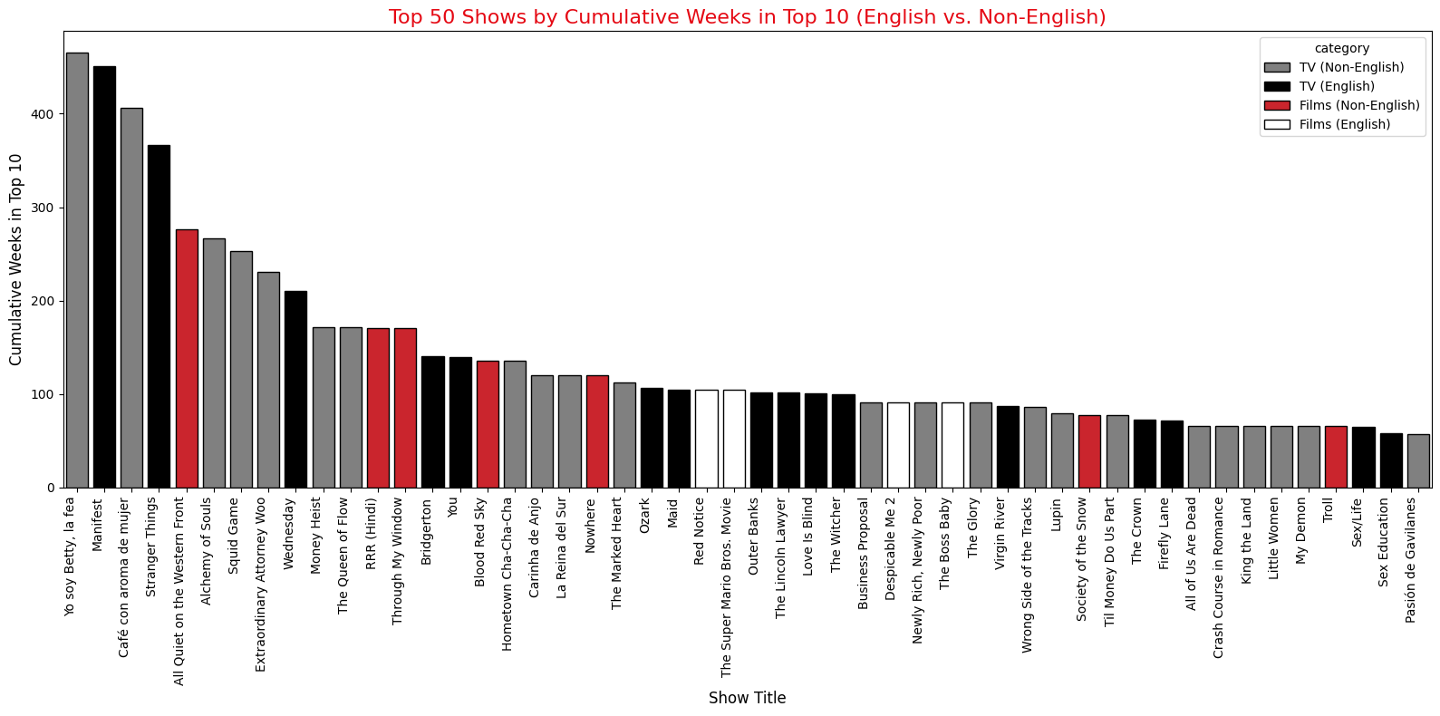
Top 50 Shows by Cumulative Weeks in Top 10 (English vs. Non-English)
Yo soy Betty, la fea leads the list with over 400 cumulative weeks in the Top 10, signaling the increasing impact of non-English shows on a global scale. However, English-language shows like Stranger Things also maintain strong positions. This data underscores the growing importance of localized content while also affirming the global power of English-language programming.
Key drivers of success include
Non-English content: Shows such as Yo soy Betty, la fea and Café con aroma de mujer demonstrate the rising success of non-English content, with a substantial number of cumulative weeks in the Top 10.
English-language dominance: While non-English content grows, English-language shows such as Stranger Things and Manifest rank highly, showing global appeal.
Variety in genres: The chart features a diverse mix of genres, from drama and romance to thrillers, which indicates that Netflix's strategy of offering genre diversity resonates with a broad audience.

Slide 5
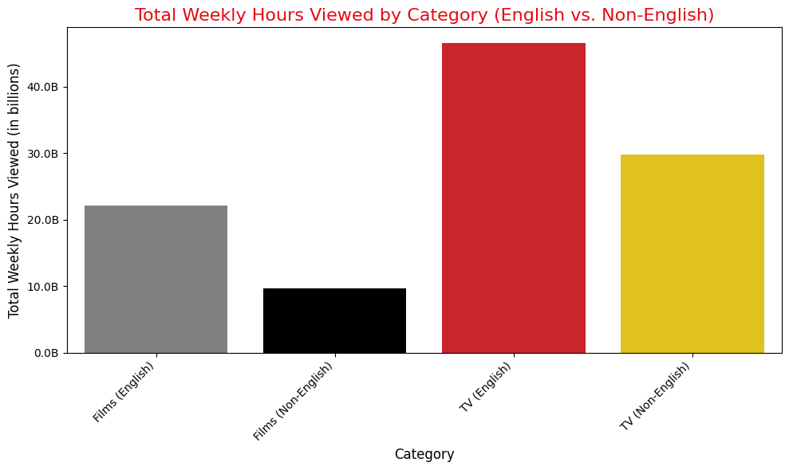
Total Weekly Hours Viewed By Category (English vs. Non-English)
Key insights:
English TV dominates: English TV shows perform exceptionally well, with significantly higher weekly hours viewed than films and non-English content.
Serialized content drives engagement: TV shows, especially long-running series, tend to have higher cumulative hours viewed as they keep audiences returning week after week.
Non-English TV growth: While English content leads, non-English TV shows also show strong engagement, indicating a growing appetite for international programming.
English TV shows significantly outperform other categories, underscoring the importance of high-quality, serialized content in maintaining audience engagement. The ability of serialized shows to retain viewers over multiple episodes and seasons makes them a powerful tool for sustaining long-term viewership.

Slide 6
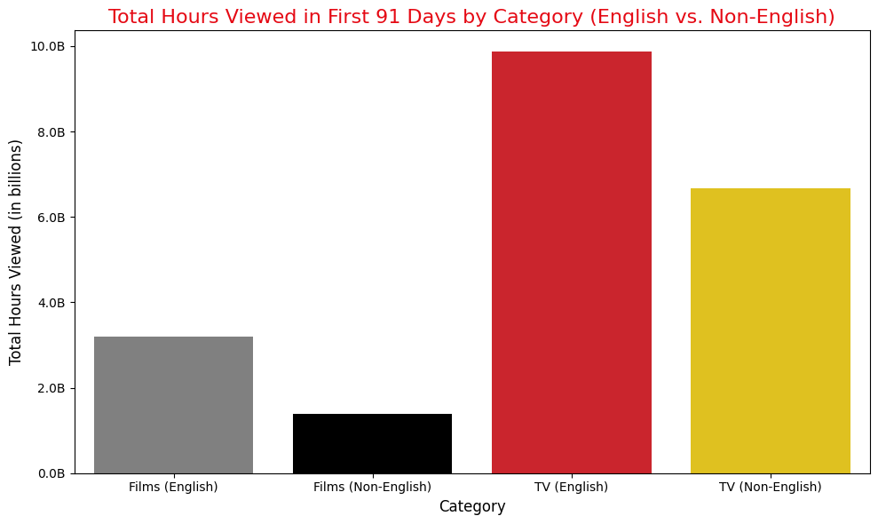
Total Hours Viewed in The First 91 Days by Category (English vs. Non-English)
Key insights:
TV (English) leads: English-language TV content outperforms other categories in the critical first 91 days, reflecting the strong appeal of serialized content to global audiences.
Importance of early engagement: Shows that perform well early in their release cycle tend to maintain high levels of engagement, reinforcing the importance of solid promotional strategies at launch.
Non-English content growth: While English content leads, non-English TV and films show competitive early engagement, indicating potential growth in international markets.
TV (English) content drives the highest engagement early on, with over 8 billion hours viewed in the first 91 days. This underscores the importance of the initial performance for a show's overall success. A strong launch strategy that captures immediate attention is crucial for ensuring long-term viewership and retention.

Slide 7
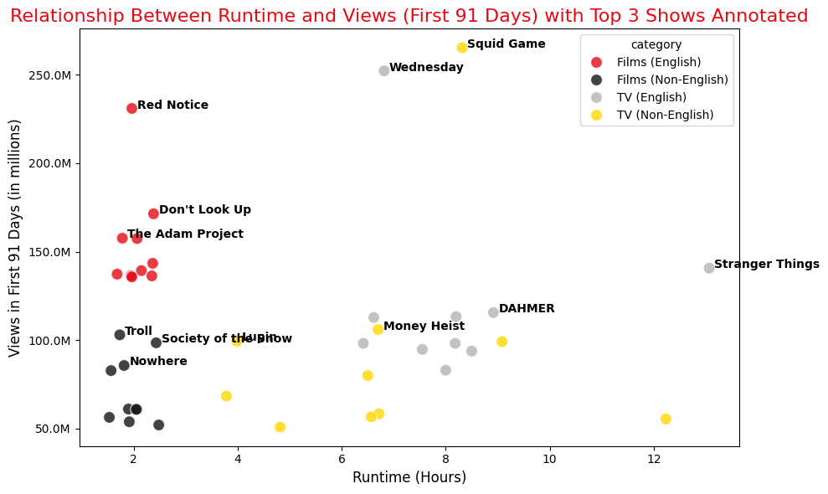
Relationship Between Runtime and Views (First 91 Days)
Key insights:
Longer runtime leads to higher engagement: TV shows with longer runtimes, such as multi-episode series, generate higher views as audiences spend more time-consuming episodic content.
Short-form content success: While longer content performs well, successful films like Red Notice and Don’t Look Up show that shorter runtime films can still achieve high engagement with effective promotion and strong audience appeal.
Diverse audience needs: The variety in successful content lengths demonstrates that Netflix can cater to both viewers who prefer binge-watching long series and those who favor shorter, standalone films.
Longer TV series such as Stranger Things and Squid Game show that higher runtime correlates with higher viewership, emphasizing the importance of serialized, long-form content. However, the success of shorter films like Red Notice shows that runtime is not the sole determinant of success. Targeted marketing and strong storylines can drive engagement for shorter films.

Slide 8
Relationship Between Runtime and Views (First 91 Days)
1. Invest in High-Performing, Serialized Content
2. Expand Non-English Programming
3. Focus on Early-Engagement Marketing for Key Launches
Insight: TV (English) content, particularly serialized shows like Stranger Things and Squid Game, consistently drives the highest global engagement in early launch periods.
Recommendation: Create and promote serialized content that retains viewers over multiple episodes and seasons. These shows show higher retention and longer viewership windows, making them crucial for long-term engagement and customer loyalty.
Insight: TV (English) content, particularly serialized shows like Stranger Things and Squid Game, consistently drives the highest global engagement and in early launch periods.
Recommendation: Create and promote serialized content that retains viewers over multiple episodes and seasons. These shows show higher retention and longer viewership windows, making them crucial for long-term engagement and customer loyalty.
Insight: Shows that do well in the first 91 days after release are more likely to become long-term global successes. Early performance is crucial for sustained engagement.
Recommendation: Design and execute high-impact launch campaigns for new content. Tailor promotional efforts to capitalize on early momentum through social media, targeted ads, and partnerships to ensure that new releases achieve maximum visibility.
4. Leverage Data to Optimize Runtime Strategies
5. Prioritize High-Engagement Markets for Localized Content
6. Maximize Global Appeal through Genre and Cultural Diversity
Insight: Longer TV series generally correlate with higher total views, but shorter films like Red Notice can perform exceptionally well with the proper marketing.
Recommendation: Maintain a balanced portfolio of long-form TV content and shorter films, each with optimized marketing strategies. While long-form content builds sustained engagement, shorter films offer high-impact entertainment that can attract broad audiences quickly.
Insight: TV (English) content, particularly serialized shows like Stranger Things and Squid Game, consistently drives the highest global engagement in early launch periods.
Recommendation: Create and promote serialized content that retains viewers over multiple episodes and seasons. These shows show higher retention and longer viewership windows, making them crucial for long-term engagement and customer loyalty.
Insight: Top-performing content includes a mix of genres, from sci-fi and fantasy to romance and thrillers, reflecting diverse audience preferences globally.
Recommendation: To diversify the content library and offer various genres and formats. Experiment with cross-genre content (e.g., sci-fi thrillers and romantic comedies) to reach new audiences and boost global appeal. Use data insights to identify emerging genre trends and create resonant content.

Slide 9
Executive Summary
Netflix can maintain its industry leadership by focusing on high-performing serialized content, local non-English programming, and data-driven strategies. Expanding into key international markets and offering a mix of long-form series and impactful short films will help grow its subscriber base and engage diverse audiences.

